Slide 1
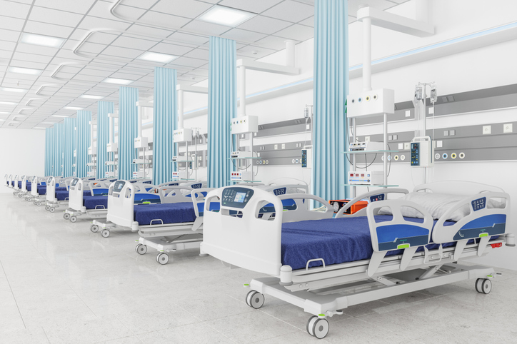
Design Kata
Problem Statement
Smart Hospital ICU Management System

Slide 2

Smart Hospital ICU Management System
Kata Topic
The goal is to enable real-time visibility of bed and ICU availability across departments while ensuring priority handling for emergency and critical patients. The system must be highly available, scalable, and capable of supporting future expansion of wards, specialties, and medical services

Slide 3

Context
Hospitals face frequent bed shortages during peak times
Manual bed allocation leads to delays and errors
ICU beds need priority handling and real-time monitoring
Inter-department coordination is weak
System downtime can directly impact patient lives
Bed availability information is often outdated or inconsistent across departments
Patient admissions, transfers, and discharges are not well synchronized
Growing patient volumes strain existing hospital infrastructure

Slide 4
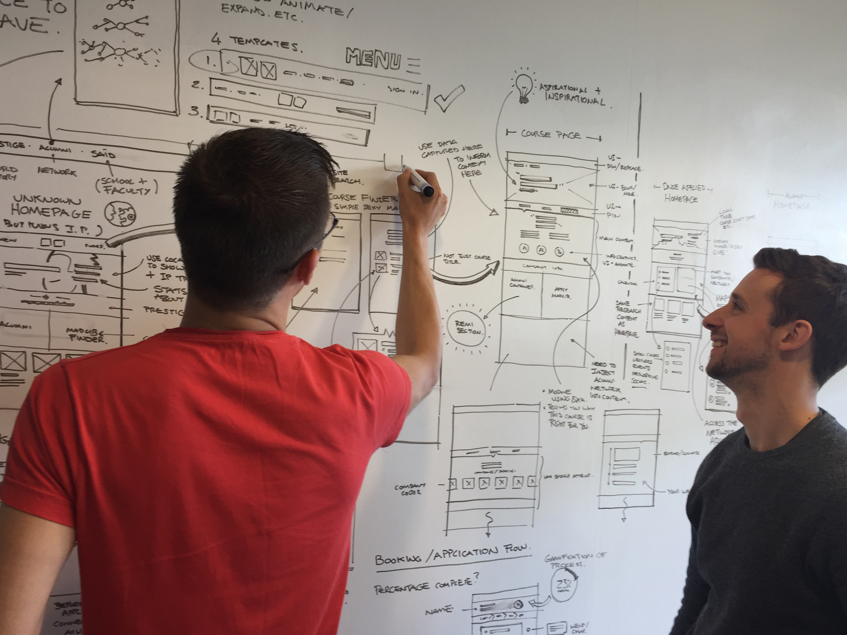
Requirements
The system should provide real-time visibility of bed availability across all wards and ICUs, showing current status such as occupied, available, reserved, or under maintenance.
The system should support priority-based bed allocation, ensuring emergency, critical, and ICU patients are assigned beds ahead of non-critical patients.
It should integrate with patient admission, discharge, and transfer workflows, automatically updating bed status as patients move through the hospital.
The system should send automated alerts and notifications to relevant staff when beds become available, are reserved, or require immediate attention.
It should support different bed categories (general, ICU, isolation, ventilator-enabled) and ensure patients are allocated beds based on clinical needs.
The system should allow temporary reservation of beds during admission or transfer processes, with automatic release if the process is not completed.
The system should allow authorized staff to manually override allocations in exceptional or emergency situations, with all actions audited.

Slide 5
Extended requirements
As an admission desk staff, I want to see real-time availability of beds across all wards and ICUs so that I can assign beds quickly without manual verification.
As a doctor, I want emergency and critical patients to be prioritized automatically for bed allocation so that life-threatening cases are handled without delay.
As a nurse, I want the system to update bed status automatically when a patient is admitted, transferred, or discharged so that bed information is always accurate.
As hospital staff, I want to receive notifications when beds become available or require attention so that I can act promptly.
As a hospital administrator, I want beds to be categorized (general, ICU, isolation, ventilator-enabled) so that patients are allocated beds matching their clinical needs.
Notes:
Answers to Potential Questions:
While we encourage the participants to think in NFRs. The relevant NFRs are:
Configurability
Maintainability
Security – Needed – OAuth based but not be focused on.
Out of Scope:
High Scalability – Given the simple use case it won’t be needed
Microservices – Not needed.

Slide 6
Expected Outcomes
Class Diagrams
Database Diagram
Sequence Diagrams
Guiding Patterns & Principles
Notes:
Answers to Potential Questions:
While we encourage the participants to think in NFRs. The relevant NFRs are:
Configurability
Maintainability
Security – Needed – OAuth based but not be focused on.
Out of Scope:
High Scalability – Given the simple use case it won’t be needed
Microservices – Not needed.

Slide 8
Thank you!

